Slide 1
Course Project CEIS106
Operating Systems
Brandy Gailey
January 2025 session
Professor: Tom Walsh

Slide 2
Introduction
This course covers operating system concepts by studying Windows, Linux, mobile, and virtual systems. It explores computing system architectures and devices, with an introduction to basic scripting.

Slide 3
Course Project
Operating Systems
Module 2 Linux Filesystem Hierarchy

Slide 4
Navigate the Linux filesystem tree
1. What is the pwd command an acronym for? What about the cd command?
Answer here:
pwd- print working directory and this shows the path for the current directory
cd- change directory- change over to the directory that you specify
2. Explain the differences between a relative path and an absolute/full path in Linux.
Answer here:
Relative path- path based on your current location
Absolute path- path starting from the very top of the filesystem, which is the root -- /
References:
1. Project video
2. Live session

Slide 5
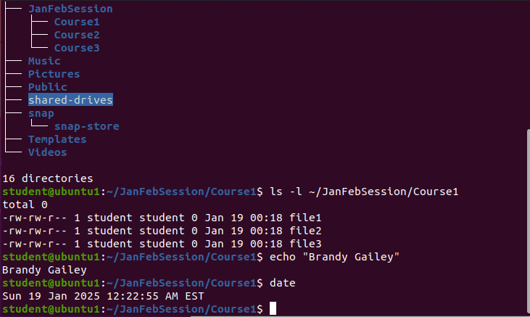
Create directories and files
Take a screenshot of the output in Steps 5 and 6.

Slide 6
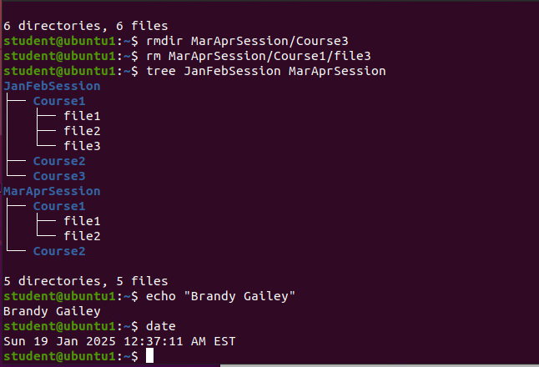
Copy and remove directories and files
Take a screenshot of the output in Step 3.

Slide 7
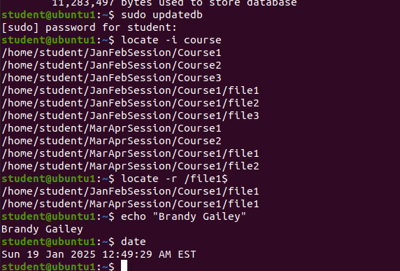
Locate directories and files
Take a screenshot of the output in Steps 5 and 6.

Slide 8
Course Project
Operating Systems
Module 3 Linux Shell Scripts

Slide 9
Create a shell script
1. What are the file permissions of the script?
Answer here:
rw-rw-r--
2. What’s the name of the user-defined variable in the script?
Answer here:
text
3. Which redirection meta-character is used in the script? What does it do?
Answer here:
>> --redirection to the file and appends to the end of the file
References:
1. Project recording
2.

Slide 10
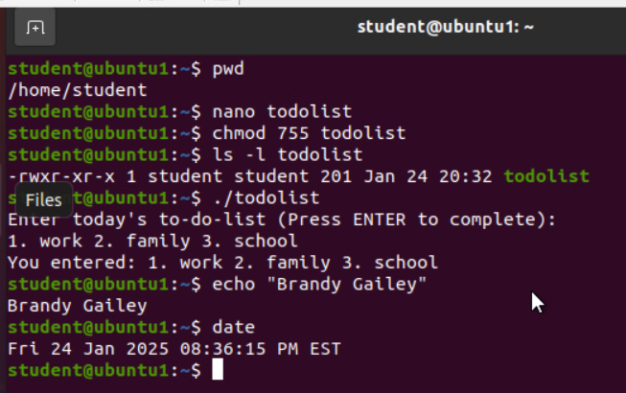
Change script file permissions
Take a screenshot of the output in Step 5.

Slide 11
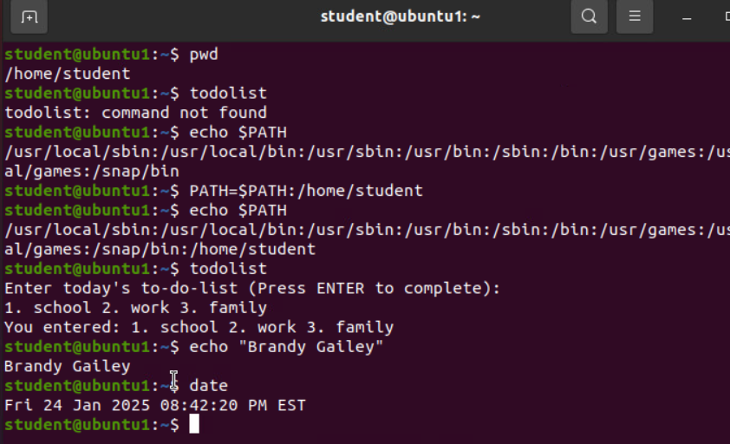
Set the PATH variable
Take a screenshot of the output in Step 6.

Slide 12
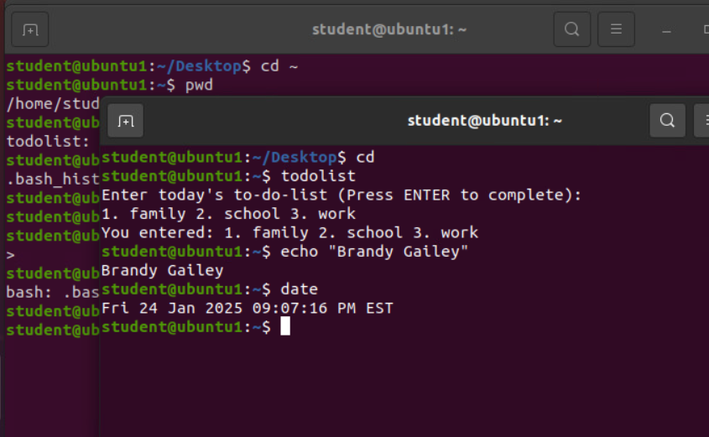
Make the PATH variable permanent
Run the todolist script before and after making the PATH variable permanent. Take a screenshot of both Terminal windows.

Slide 13
Course Project
Operating Systems
Module 4 User and Group Management

Slide 14
Add users and groups in CLI
1. What does the –m option in the useradd command do?
Answer here:
-m –tells useradd command to create a home directory for this new user.
2. What does the -3 option in the tail command do?
Answer here:
-3 – tells tail command how many lines to show from the end of the file.
3. Which line of the /etc/group file lists members of the “students” group? Copy it here.
Answer here:
References:
1. Project video
2.

Slide 15
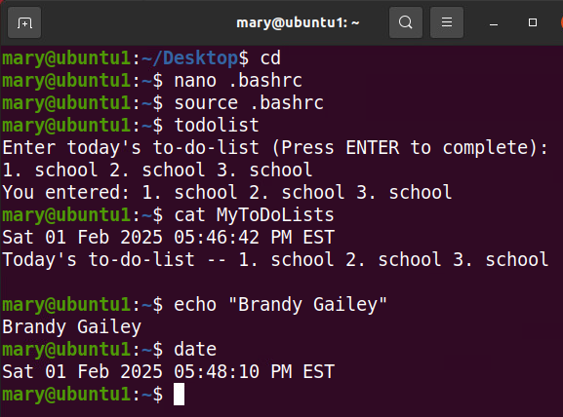
Test user and group settings
Take a screenshot of the output in Step 6.

Slide 16
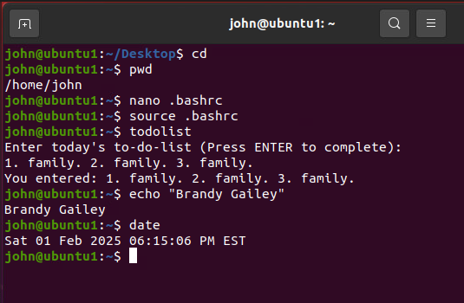
Add users in GUI
Take a screenshot of the output in Step 9.

Slide 17
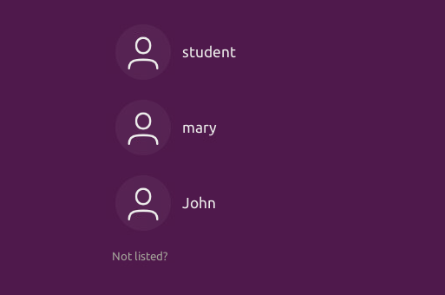
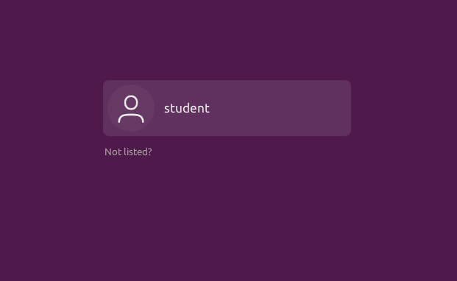
Remove users and groups
Take a screenshot of the log on page with three user accounts.
Take a screenshot of the log on page with only your user account (i.e., student).

Slide 18
Course Project
Operating Systems
Module 5 Network Configuration

Slide 19
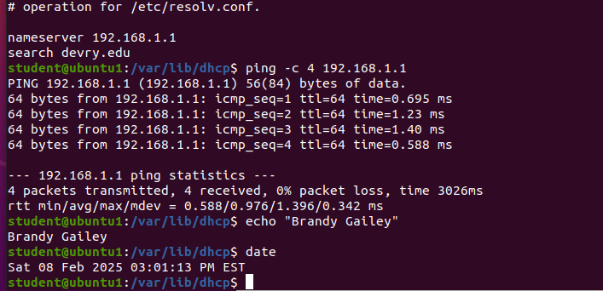
Discover host IP configurations
1. What is the IP address of your Ubuntu machine?
Answer here:
192.168.107
2. What is the IP address of its default gateway?
Answer here:
192.168.1.1
3. What is the IP address of its DHCP server?
Answer here:
192.168.1.1
4. What is the IP address of its DNS server?
Answer here:
192.168.1.1
Take a screen capture of the output in Step 12.

Slide 20

Manage network interfaces
Which DHCP message is shown in the output of the sudo dhclient –v –r eth0 command?
Answer here:
DHCPRLEASE
2. Which four DHCP messages are shown in the output of the sudo dhclient –v eth0 command?
Answer here:
DHCPDISCOVER
DHCPOFFER
DHCPREQUEST
DHCPACK

Slide 21
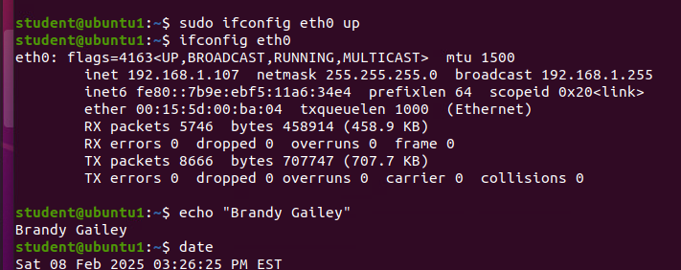
Use network utilities
Take a screen capture of the output in Step 7 and Step 8.

Slide 22
Course Project
Operating Systems
Module 6 System Performance Monitoring

Slide 23
Monitor Linux processes
1. What is the default action of the 15 SIGTERM kill signal?
Answer here: Kill the highlighted process.
2. In the System Monitor window, click on % CPU to sort the processes by CPU load. Which process shows the highest percentage of CPU usage?
Answer here: gnome-shell (GUI)
References:
1. Project assistance video
2.

Slide 24
Monitor user activities
Issue the sudo accton on command to turn on GNC accounting. Run the sudo updatedb command. Enter lastcomm updatedb to check if the updatedb command was executed before. Remember to turn off GNC accounting (sudo accton off) after answering the questions.
1. What flag value is displayed in the output?
Answer here: S – “super user”
2. Why is the name of the user who ran the processes shown as root, not student?
Answer here: superuser – since we typed sudo in front of the command
References:
1. Project assistance video
2.

Slide 25
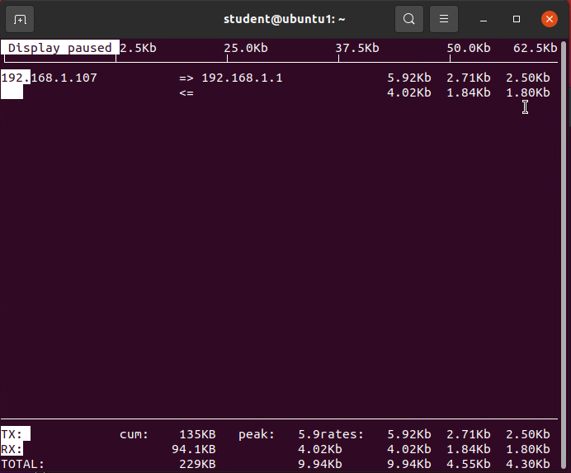
Monitor network bandwidth usage
Take a screenshot of the output in Step 4.

Slide 26
Challenges
The most challenging part of this course was getting comfortable with the command line interface (CLI). Additionally, understanding the Linux filesystem hierarchy, file permissions, and mastering essential tools and commands often presents a steep learning curve. However, I know that with practice and persistence, these challenges will become more manageable.

Slide 27
Career skills obtained
Learning about Linux Shell Scripts, User and Group Management, System Monitoring, and the Linux Filesystem Hierarchy has helped me improve with coding. I’ve also improved at working with Linux systems, solving problems, writing shell scripts, watching how systems perform, and organizing files. These are important skills for anyone in IT and have prepared me for a future career in system administration.

Slide 28
Conclusion
In conclusion, this course has allowed me to get a feel of what to expect when working in the Linux operating system. I learned how to manage user accounts and groups, write special scripts to make tasks easier, watch how the system works, and move around in the Linux computer system. These skills gave me a good start for in the future.

