Slide 1

CEIS 114
Final Project Deliverables
PowerPoint
Brandy Gailey
Prof Natalie Sommer
March2025 Session
04/26/2025

Slide 2
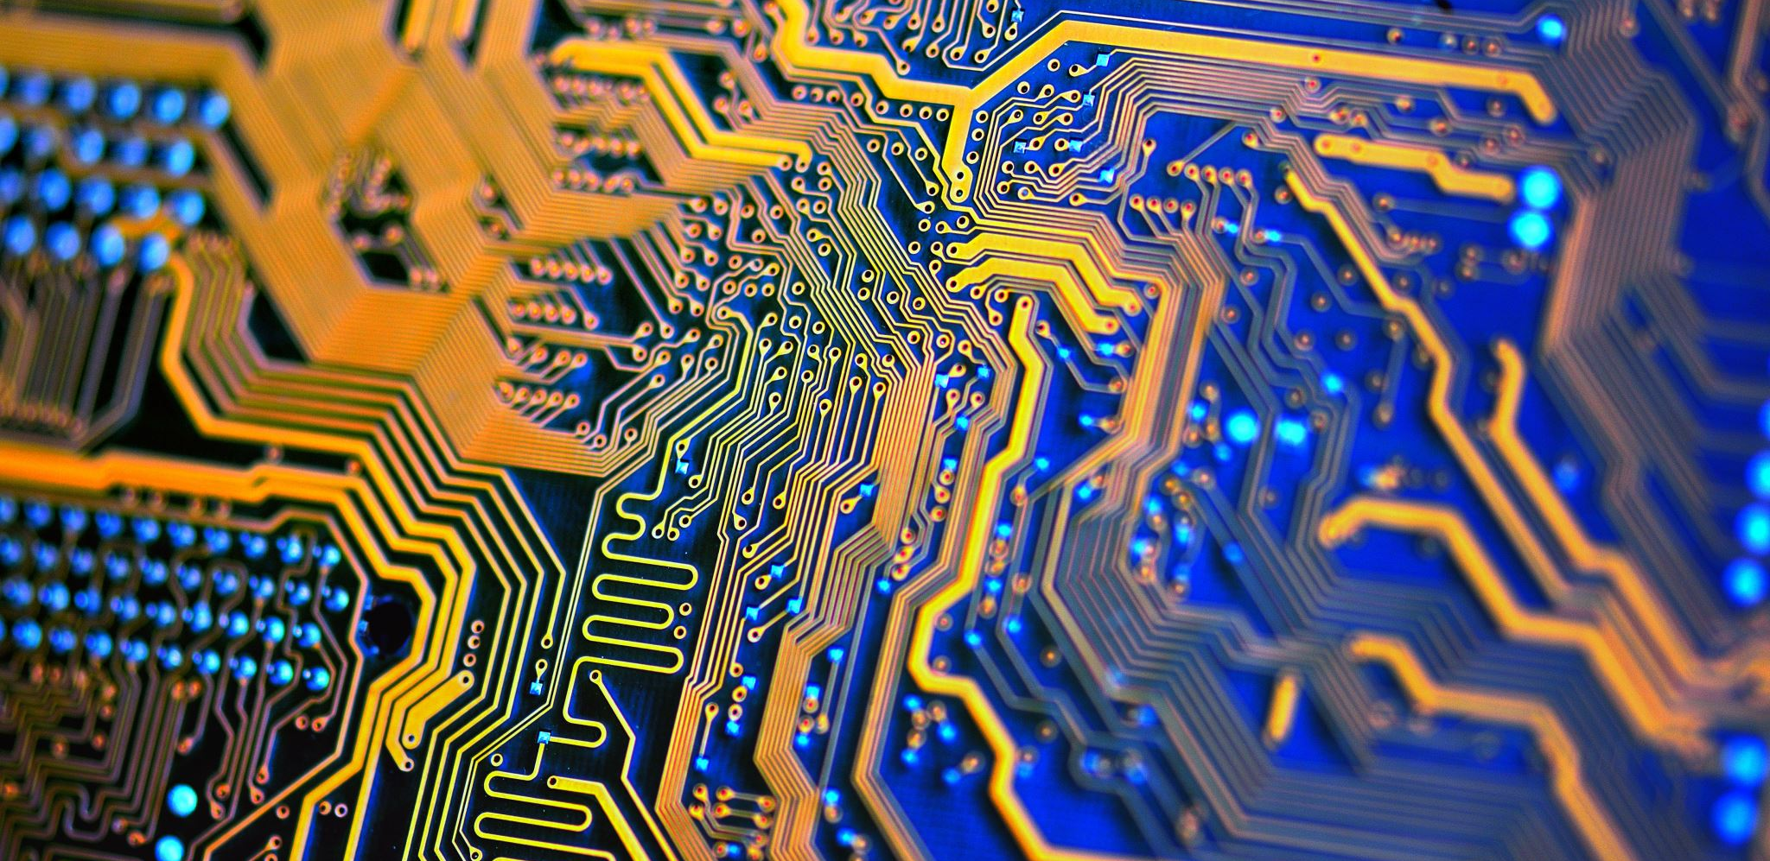
CEIS 114
Module 2
Project Plan for IoT Traffic Controller

Slide 3
Introduction
In this course project, I delved into the world of digital concepts, devices, and connectivity within the Internet of Things (IoT). The fundamentals of networking, computing, and digital devices were thoroughly examined. Throughout the course, practical applications of IoT systems and concepts were implemented. IoT solutions were developed to address industry and societal challenges from a global perspective.

Slide 4
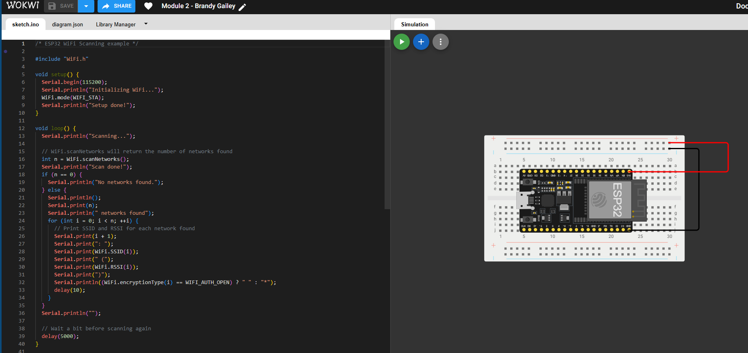
ESP32 (Screenshot)
Microcontroller mounted and powered ON

Slide 5
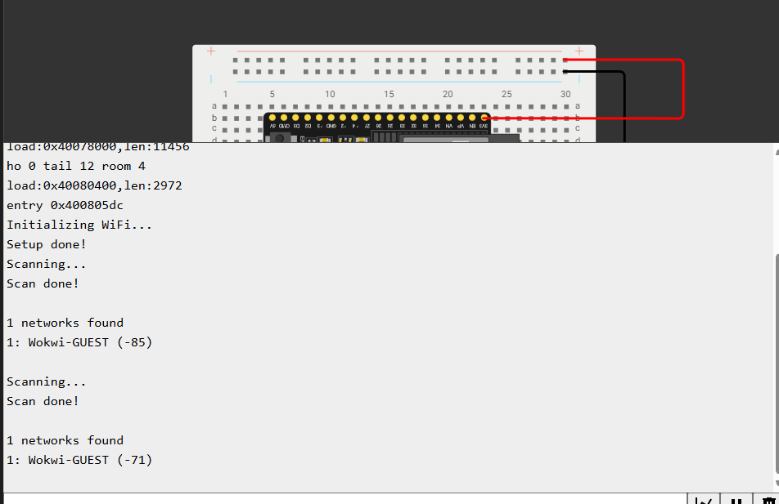
ESP32 WiFi Scan
Screenshot of Serial Monitor showing the available networks

Slide 6
CEIS 114
Module 3
Creating the Traffic Controller

Slide 7
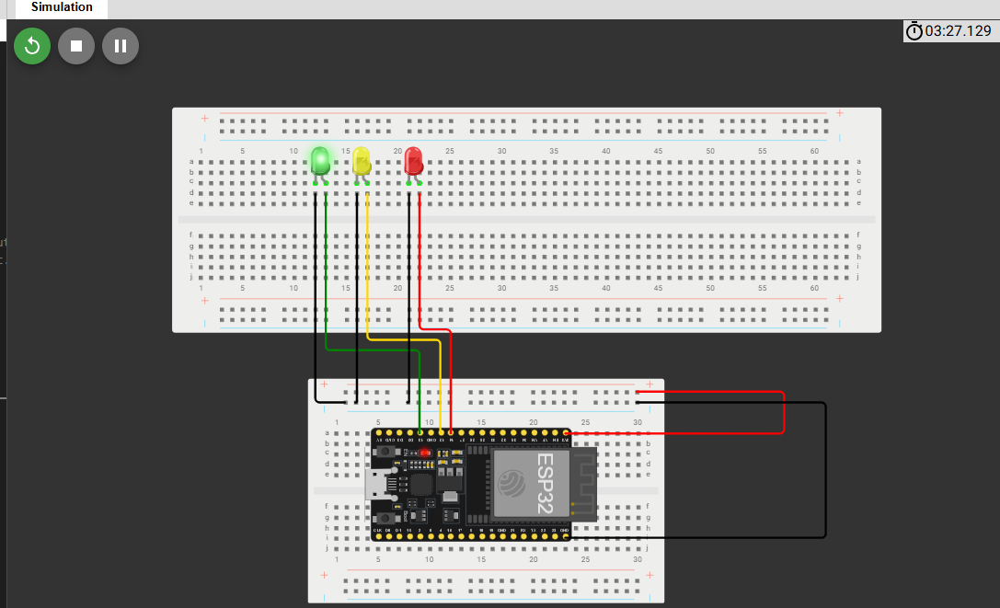
Picture of circuit with working LEDs
ESP 32 Board
Colored LEDs: Red, Yellow and Green
Wires
Breadboard

Slide 8
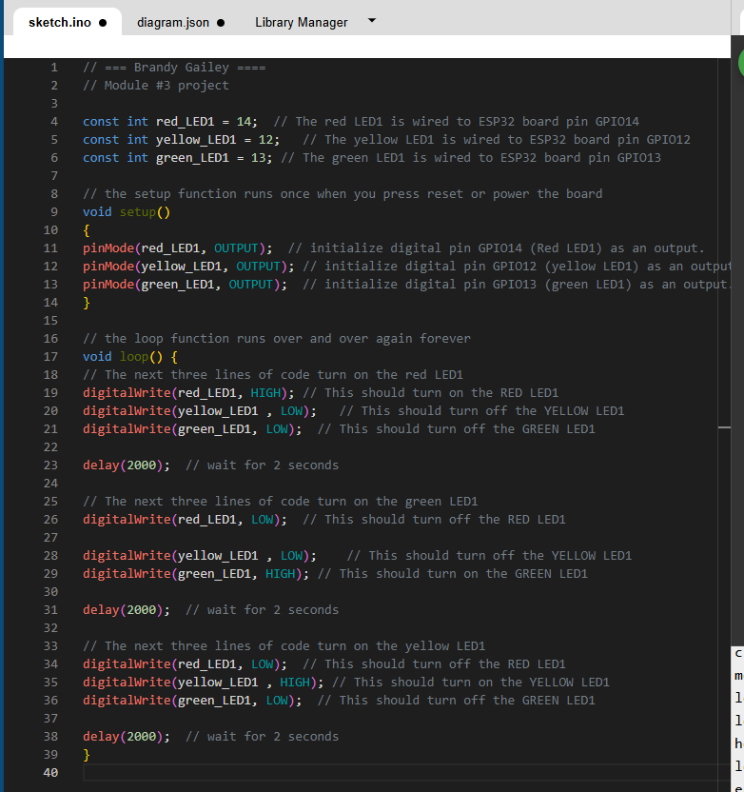
Screenshot of code in the Code Editor
Screenshot of code in the Wokwi Code Editor showing your name in the comment

Slide 9
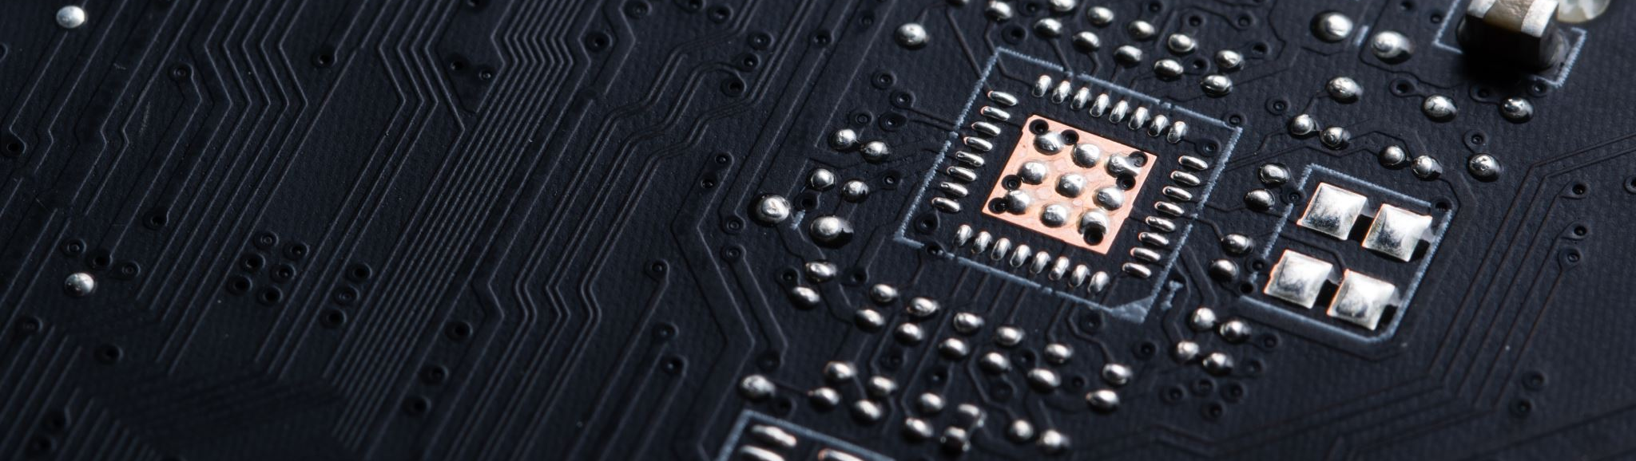
CEIS 114
Module 4
Creating a Multiple Traffic Light Controller

Slide 10
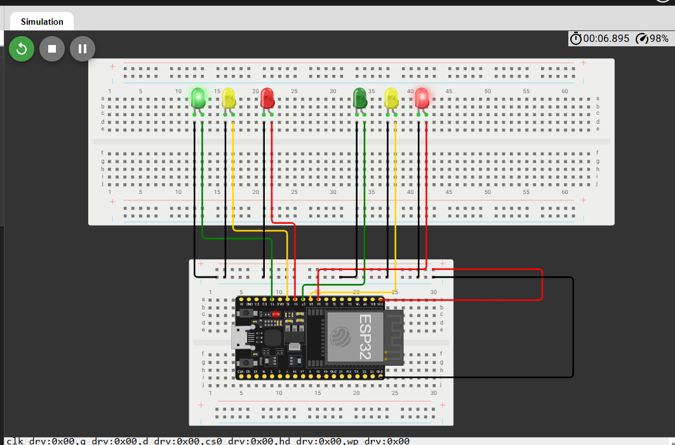
Picture of circuit with working LEDs
ESP 32 Board
Colored LEDs: Red, Yellow and Green (two sets)
Wires
Breadboard

Slide 11
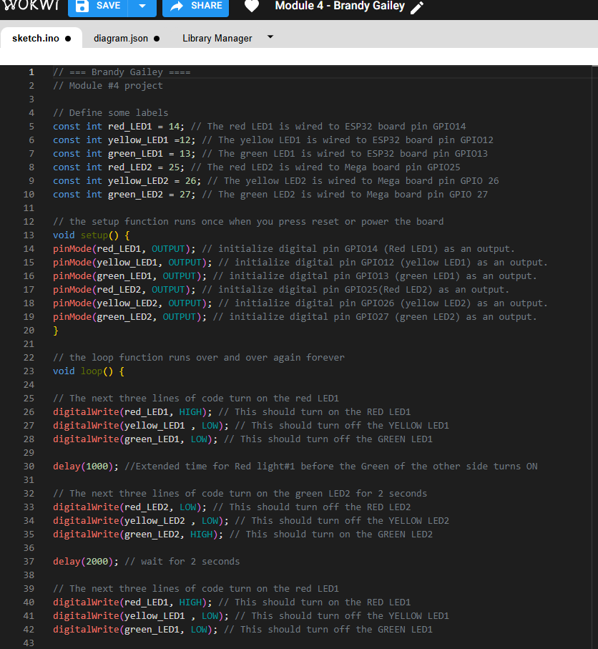
Screenshot of code in Wokwi
Screenshot of code Wokwi Code Editor showing your name in the comment

Slide 12
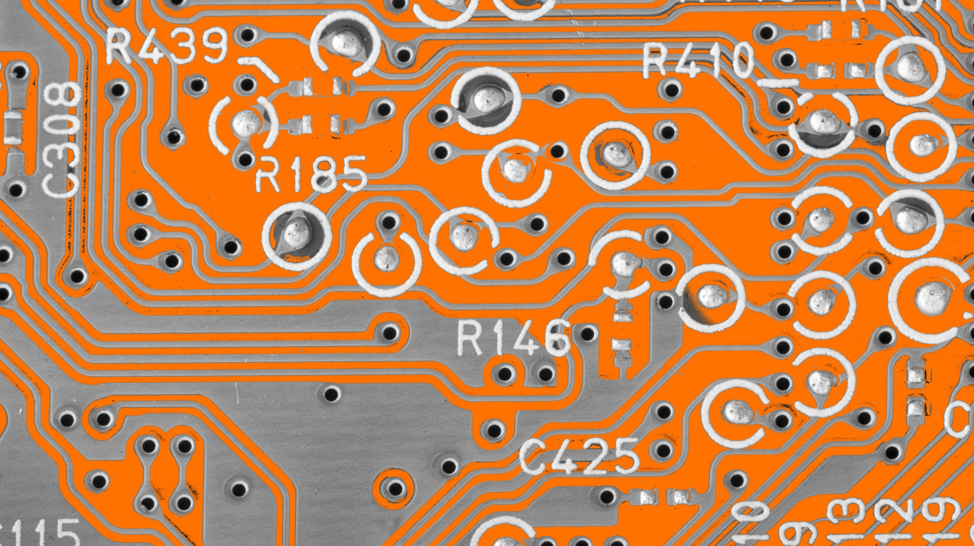
CEIS 114
Module 5
Creating a Multiple Traffic Light Controller with a Cross Walk

Slide 13
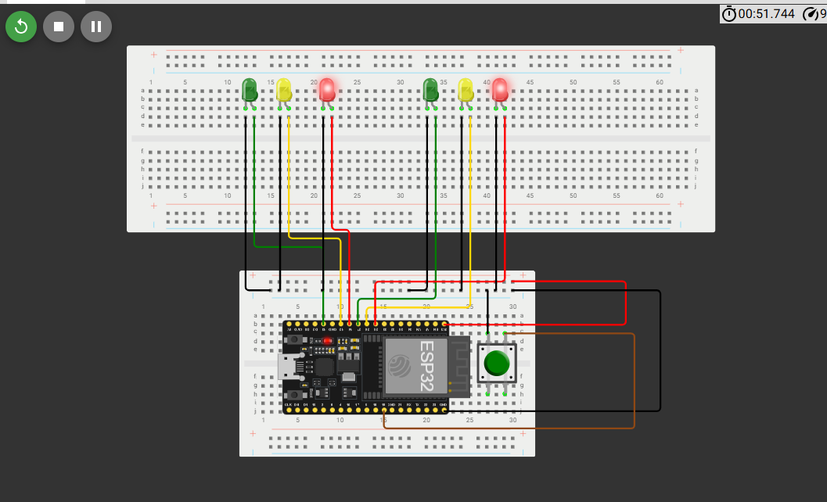
Screenshot of circuit with working LEDs
ESP 32 Board
Colored LEDs: Red, Yellow and Green (two sets)
220 Ohm Resistors (optional)
Push Button
Wires
Breadboard

Slide 14
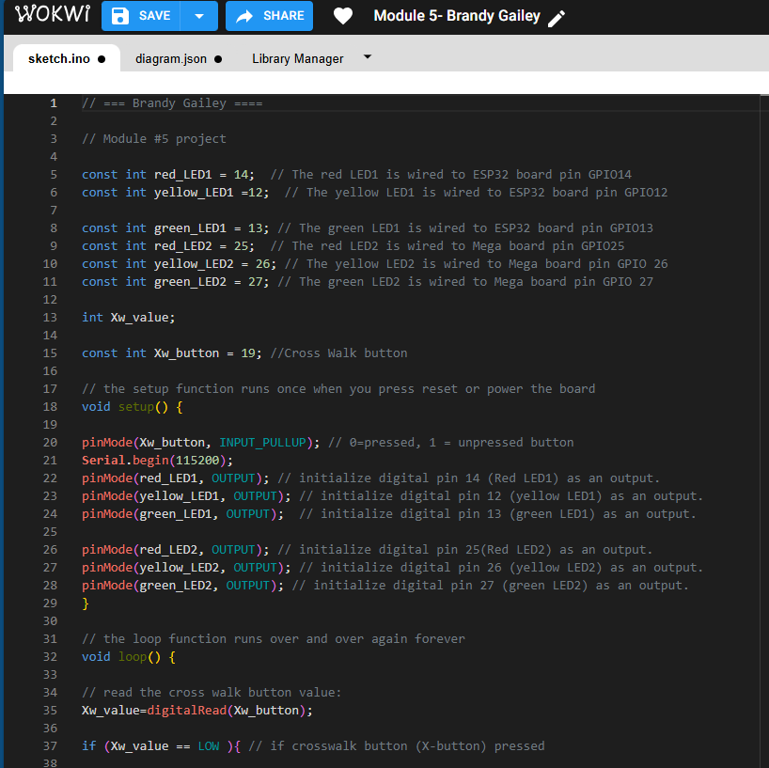
Screenshot of code in Wokwi
Screenshot of code in Wokwi Code Editor showing your name in the comment

Slide 15
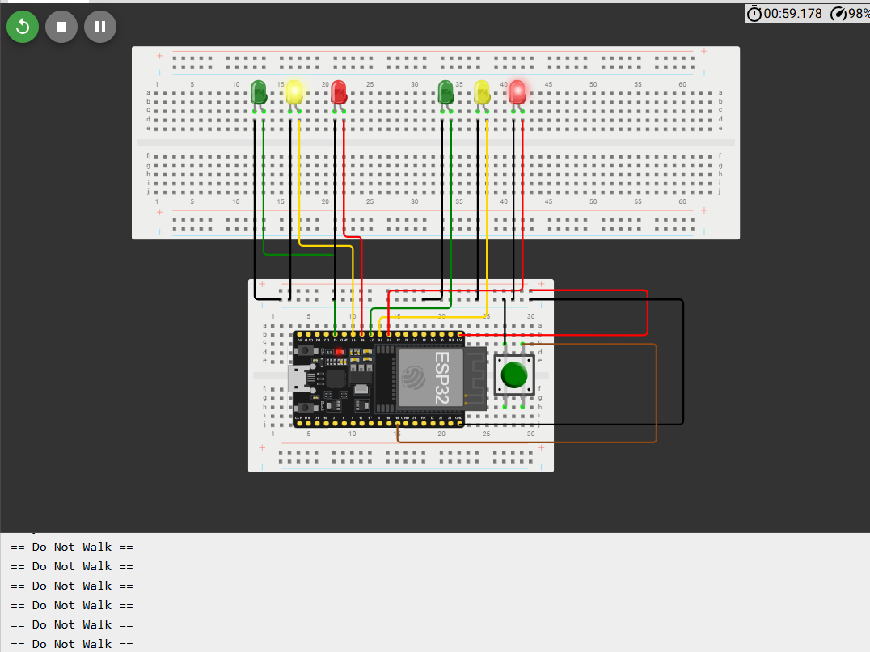
Screenshot of Serial Monitor in Wokwi
Screenshot of output in Serial Monitor

Slide 16
CEIS 114
Module 6
Creating a Multiple Traffic Light Controller with a Cross Walk and an Emergency Buzzer

Slide 17
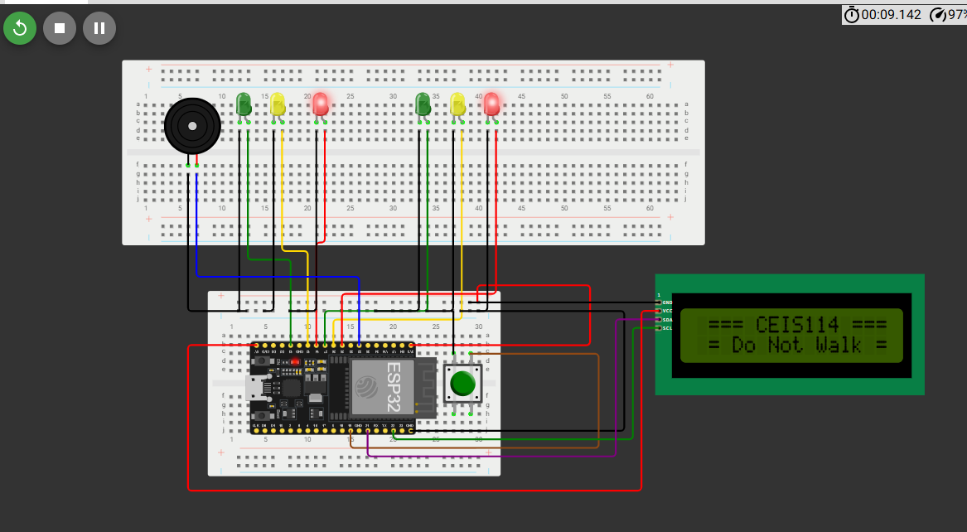
Picture of circuit with working LEDs and LCD display
ESP 32 Board
Colored LEDs: Red, Yellow and Green (two sets)
220 Ohm Resistors (optional)
Push Button
LCD Unit with Message Display
Wires
Breadboard

Slide 18
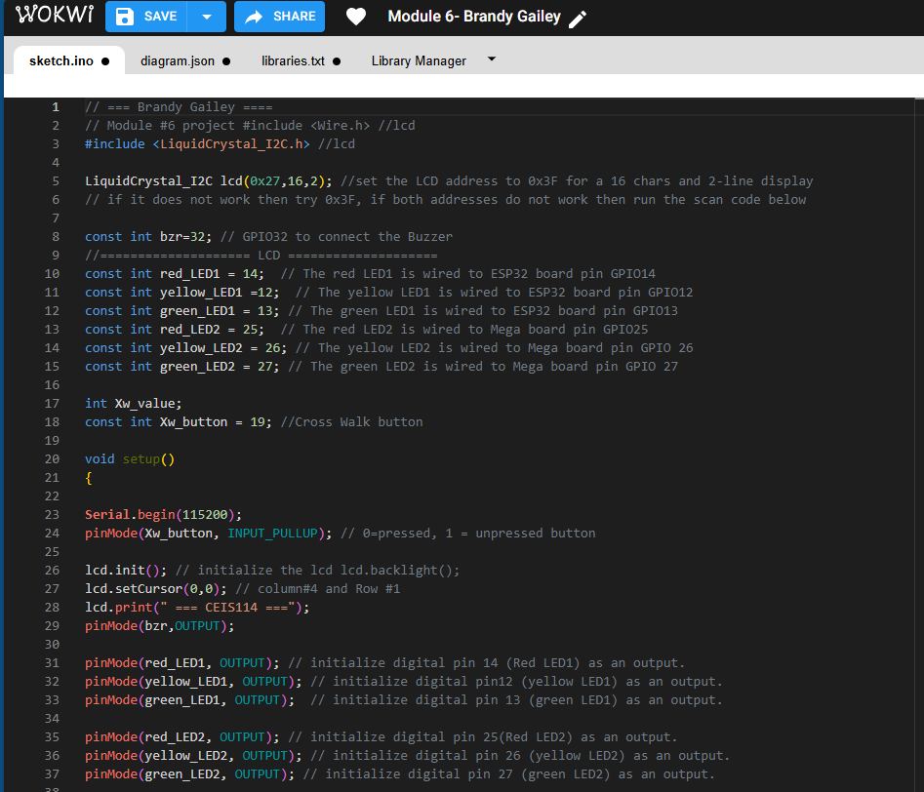
Screenshot of code in Code Editor
Screenshot of code in Code Editor showing your name in the comment

Slide 19
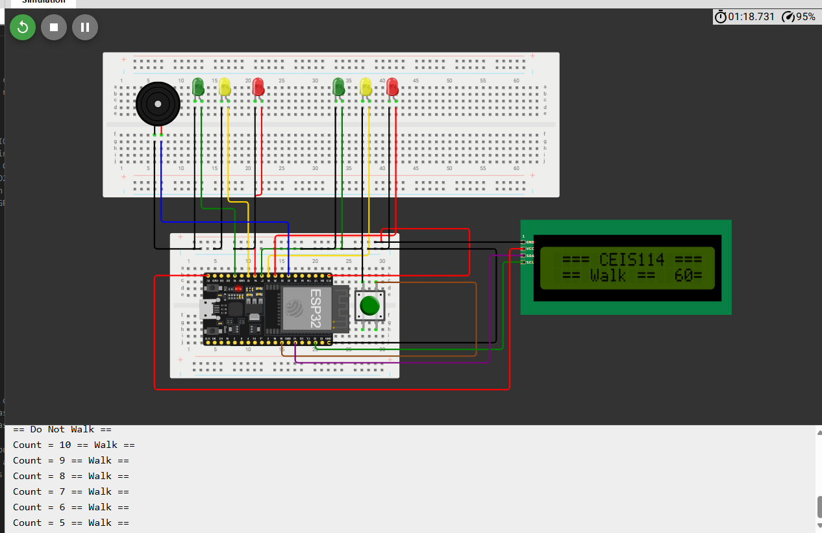
Screenshot of Serial Monitor
Screenshot of output in Serial Monitor

Slide 20
CEIS 114
Week 7 Project
Creating a Multiple Traffic Light Controller with a Cross Walk and an Emergency Buzzer with secured IoT Control via Web

Slide 21
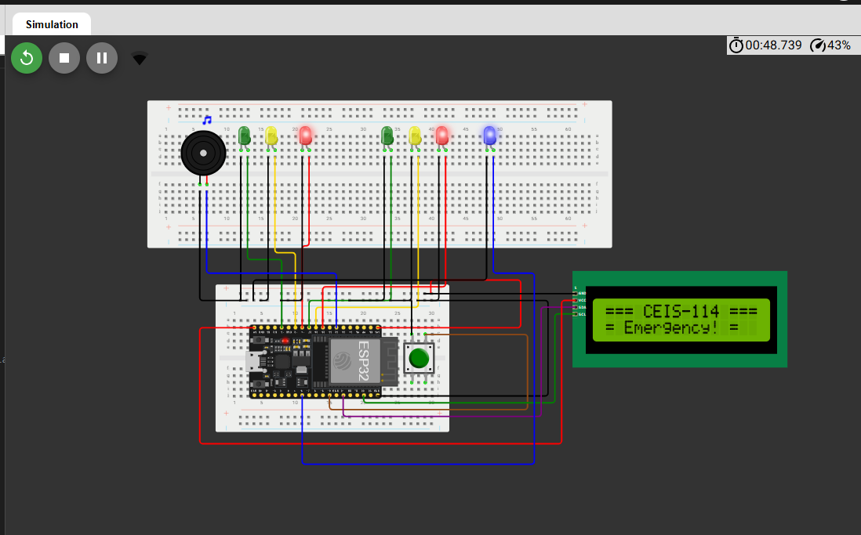
Screenshot of circuit with working LEDs and LCD display (Building/Operation)
ESP 32 Board
Colored LEDs: Red, Yellow and Green (two sets)
One Blue LED – Emergency Light
Push Button
LCD Unit
Buzzer
Wires
Breadboard

Slide 22
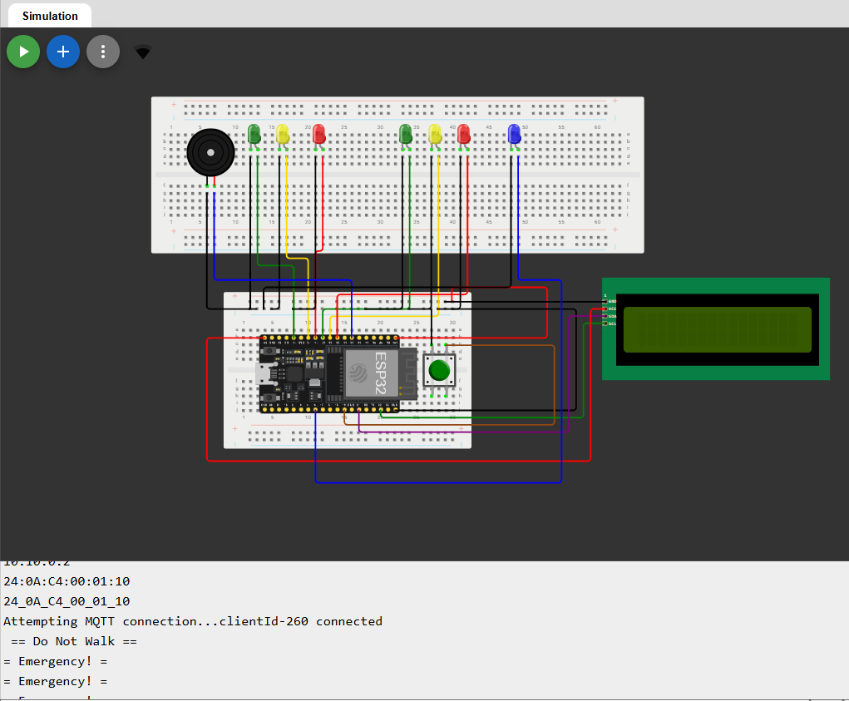
Screenshot of Serial Monitor (Testing)
Screenshot of output in Serial Monitor

Slide 23
Challenges
Connecting and configuring devices like the ESP32 board, LEDs, and sensors was the most challenging for me.

Slide 24
Career Skills
I gained hands-on experience with digital devices, sensors, and microcontrollers. I also gained an understanding of how to set up and manage network connections, which is essential for remote device control and data transmission.

Slide 25
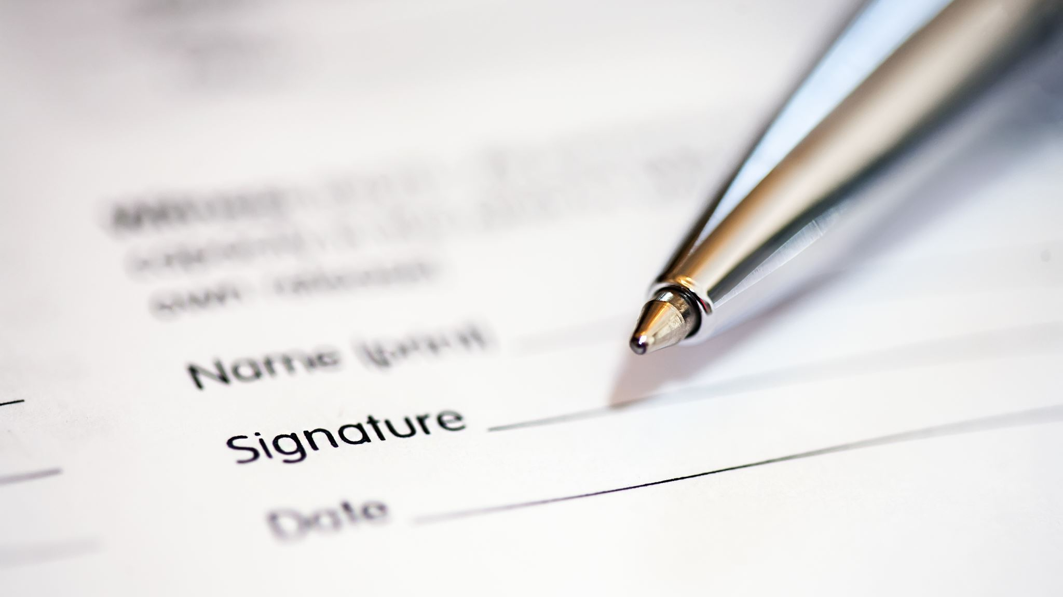
Conclusion
In conclusion, I have designed and developed a two-way traffic light controller, enhanced its security for remote control via a web browser, and integrated a SMART Sensor to dynamically adjust signal changes based on traffic flow.

