Slide 1
Final Course Project
CEIS101 Final Course Project
November 2024 session
Brandy Gailey
Prof. Bassem Maurice

Slide 2
Introduction
This course project focuses on creating a smart home automation in a virtual emulator. We dug into the basics of IoT by completing a part of the project every week, which totals six parts. We were able to learn about how software, hardware, and networks work together and learn the development and design process.
The main objective for creating the virtual emulator was to monitor the home's condition using many different devices and components. We used a door sensor, distance sensor, and automated lights. These things allowed us to check if the door was open or closed, monitor home intruders, and even turn lights on automatically when it is dark.
The tools used in the project were of course a computer along with Tinkercad, Microsoft PowerPoint, and Excel.

Slide 3
CEIS101
Module 2
Circuit Simulation in Tinkercad

Slide 4
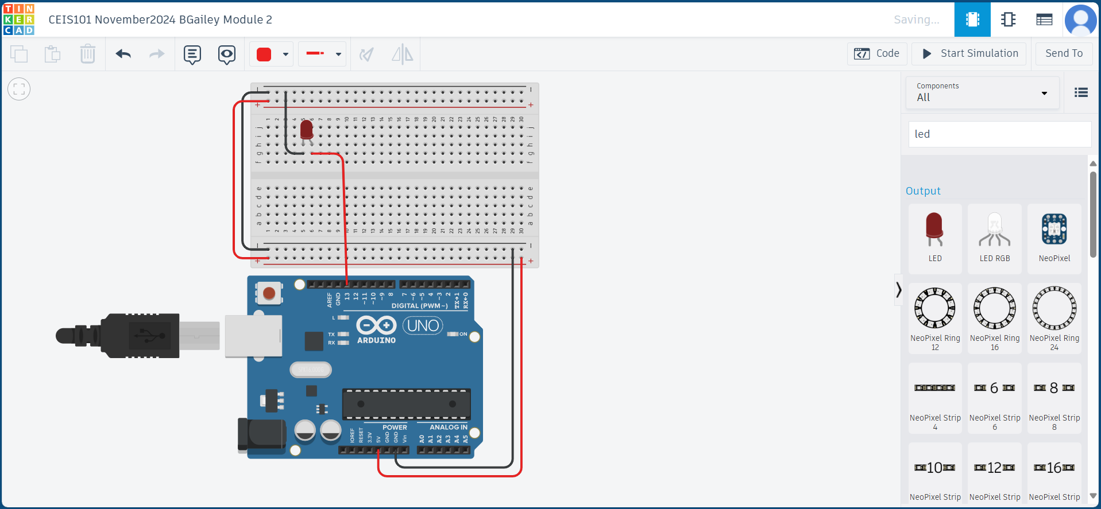
Circuit (screenshot)

Slide 5
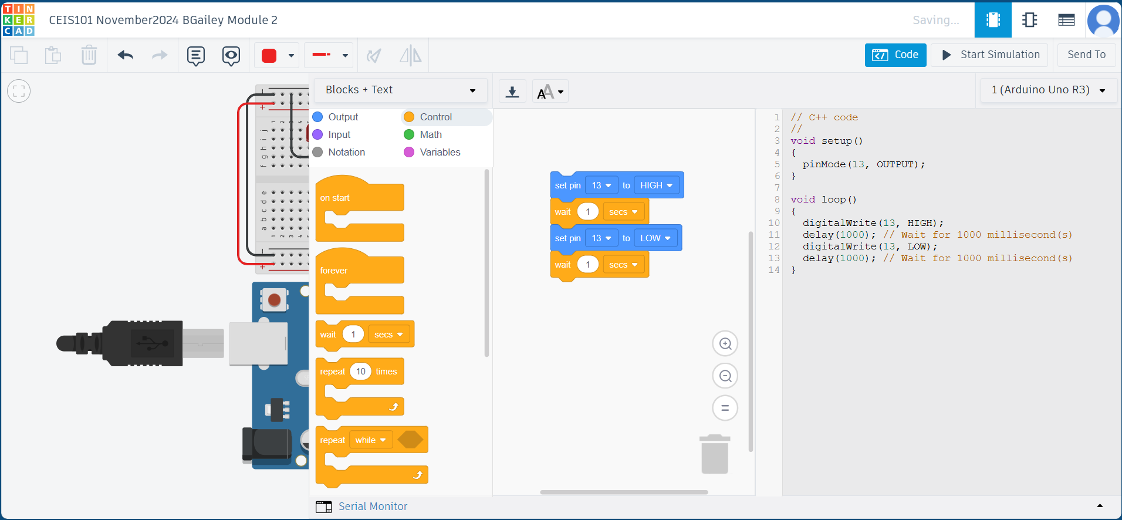
Code (screenshot)

Slide 6
CEIS101
Module 3
Inventory of Parts, Circuit Building, and Displaying Messages

Slide 7


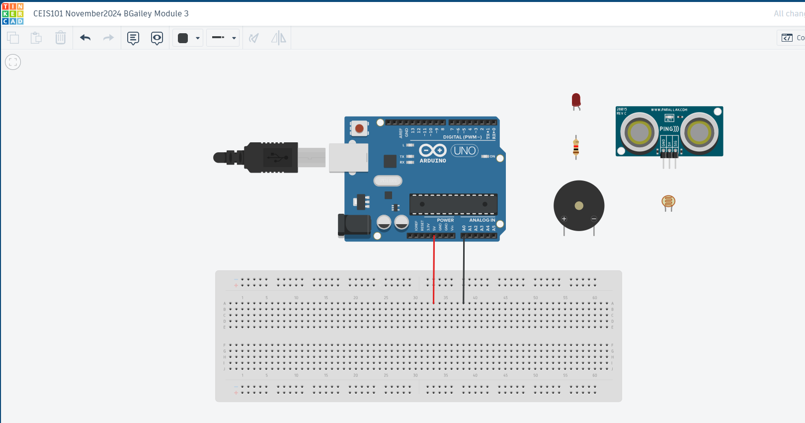

Organization of Project Components (picture)
Arduino Uno
Breadboard
Resistor 10kΩ
LEDs
Ultrasonic Sensor
Piezo
Photoresistor

Slide 8
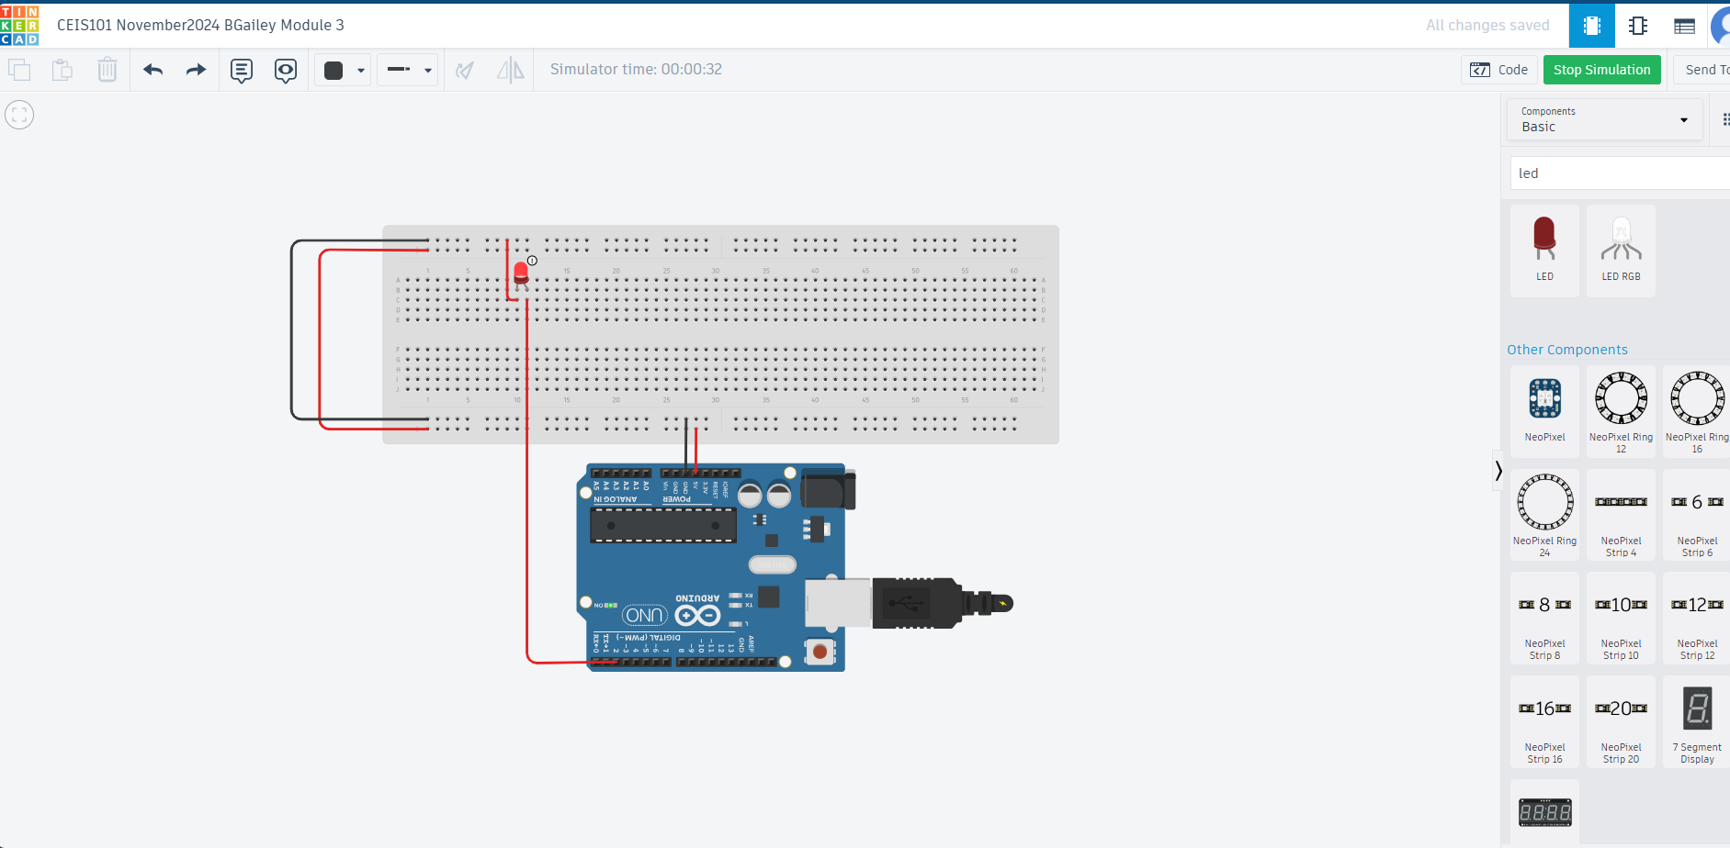
Circuit with red LED on (picture)

Slide 9
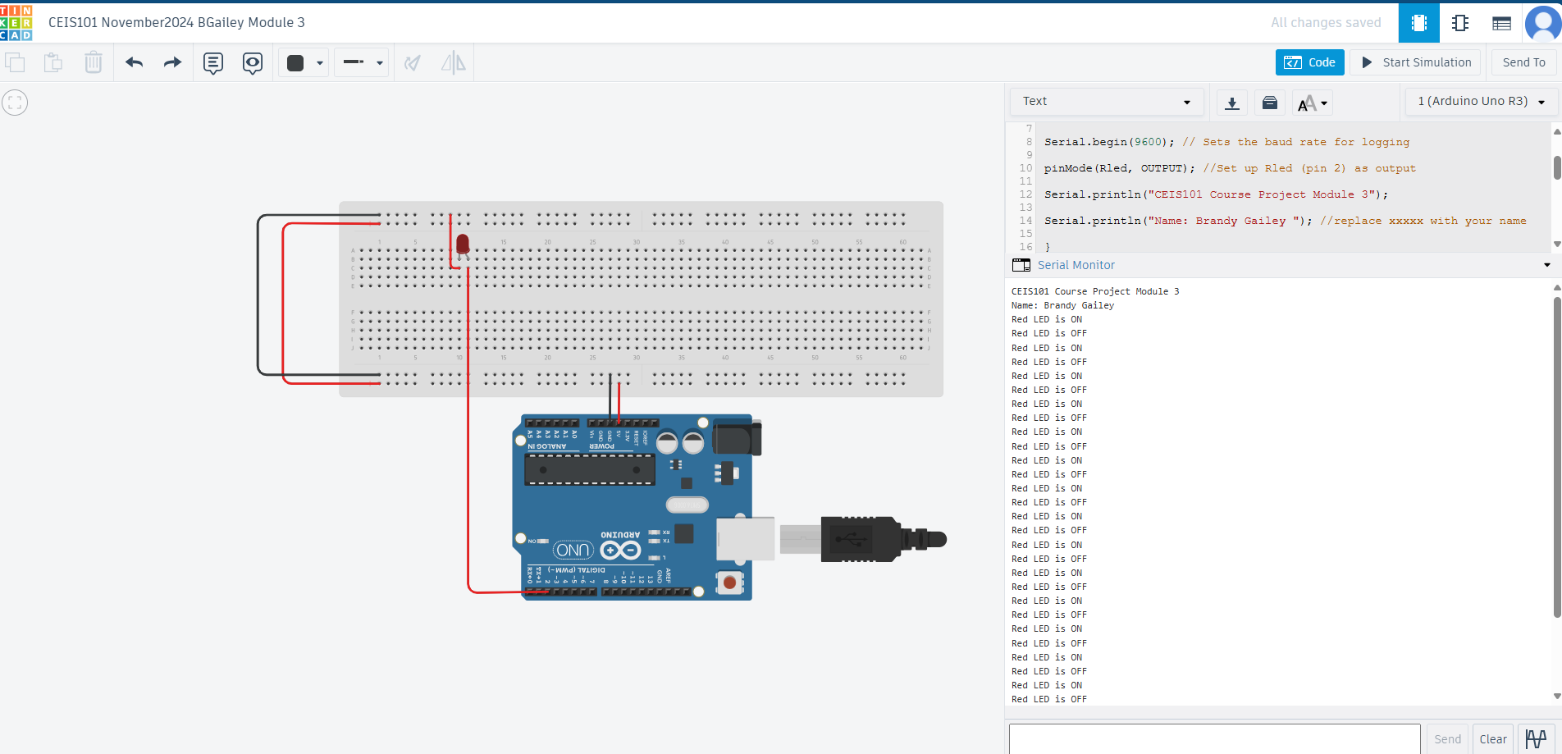
Serial Monitor (screenshot)

Slide 10
CEIS101
Module 4
Adding Door Sensor to Smart Home System

Slide 11
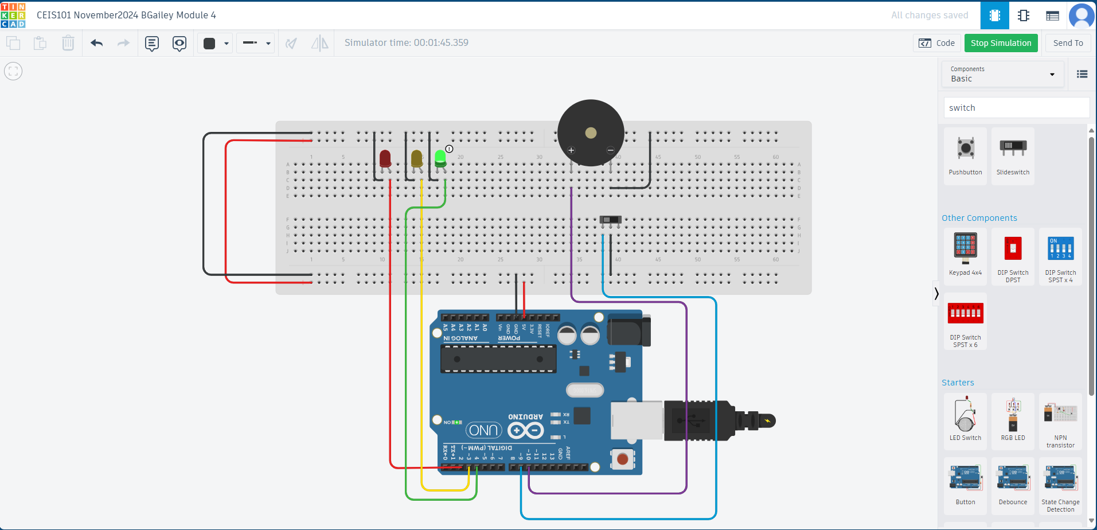
Circuit of door closed with Green LED ON (picture)

Slide 12
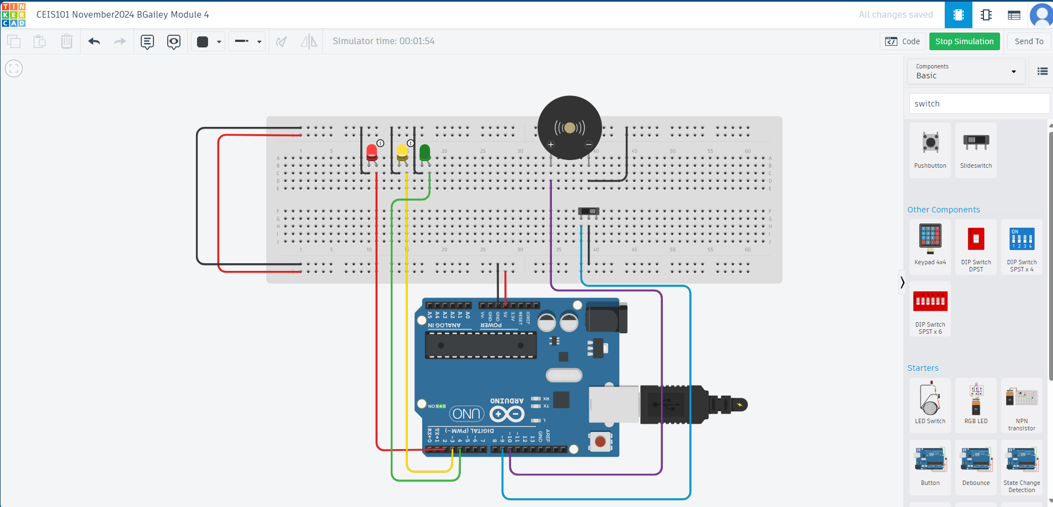
Circuit of door open with Green LED OFF (picture)

Slide 13

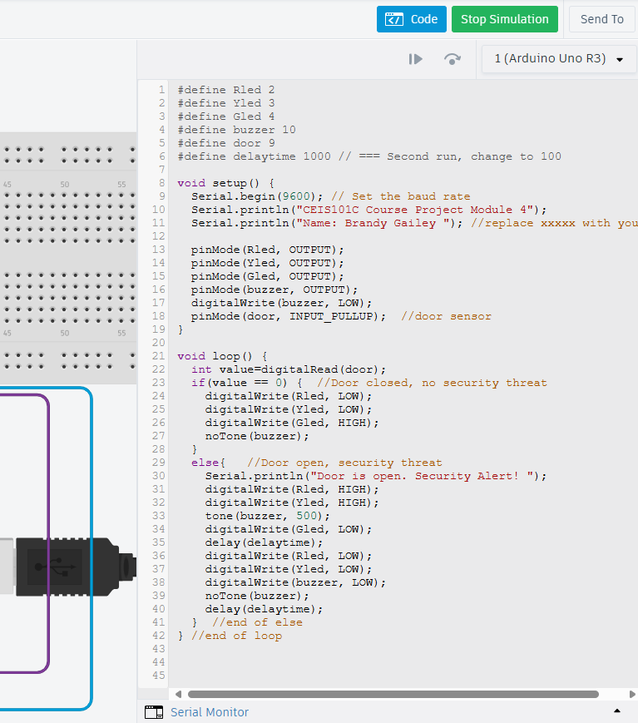
Arduino Code (screenshot)

Slide 14

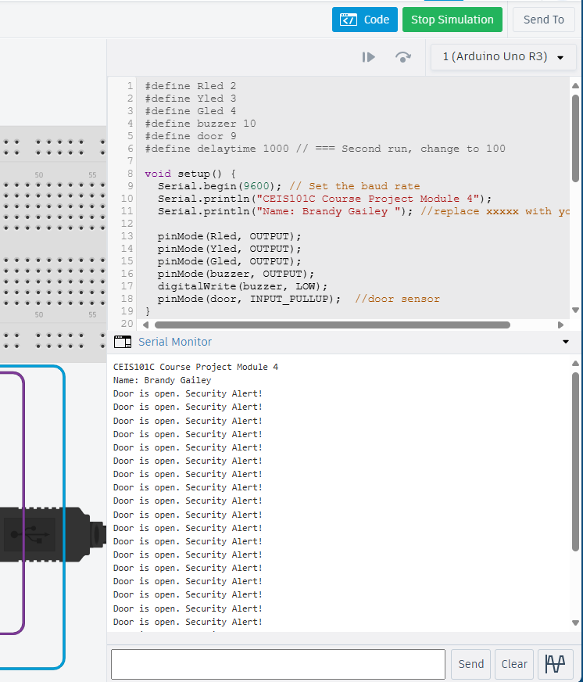

Serial Monitor (screenshot)

Slide 15
CEIS101
Module 5
Adding Distance Sensor to Smart Home System
and Conducting Data Analysis

Slide 16
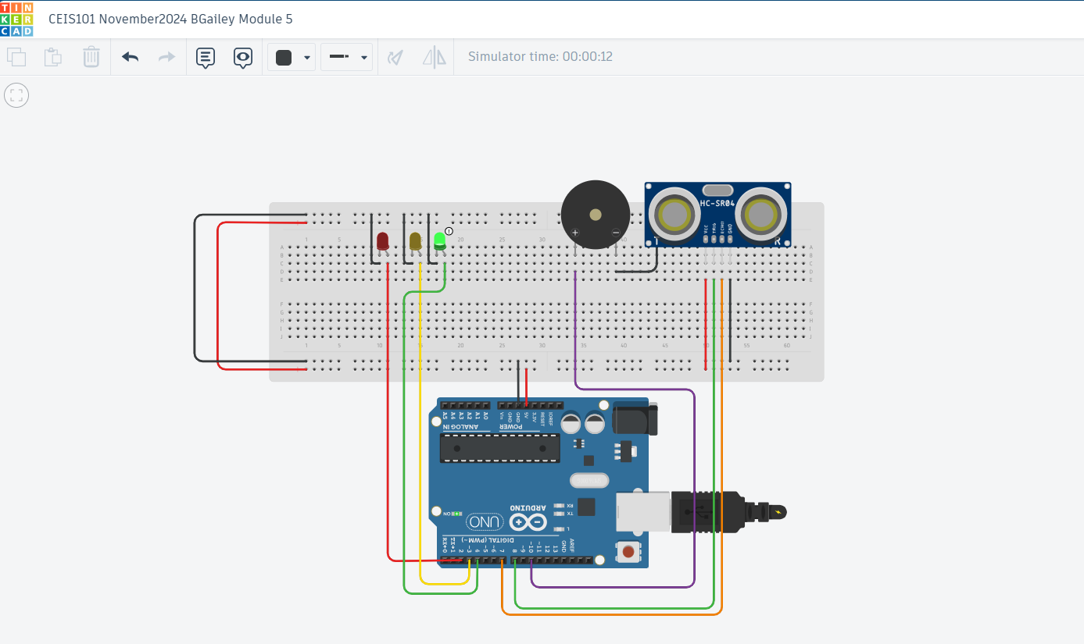
Circuit with green LED on (picture)

Slide 17
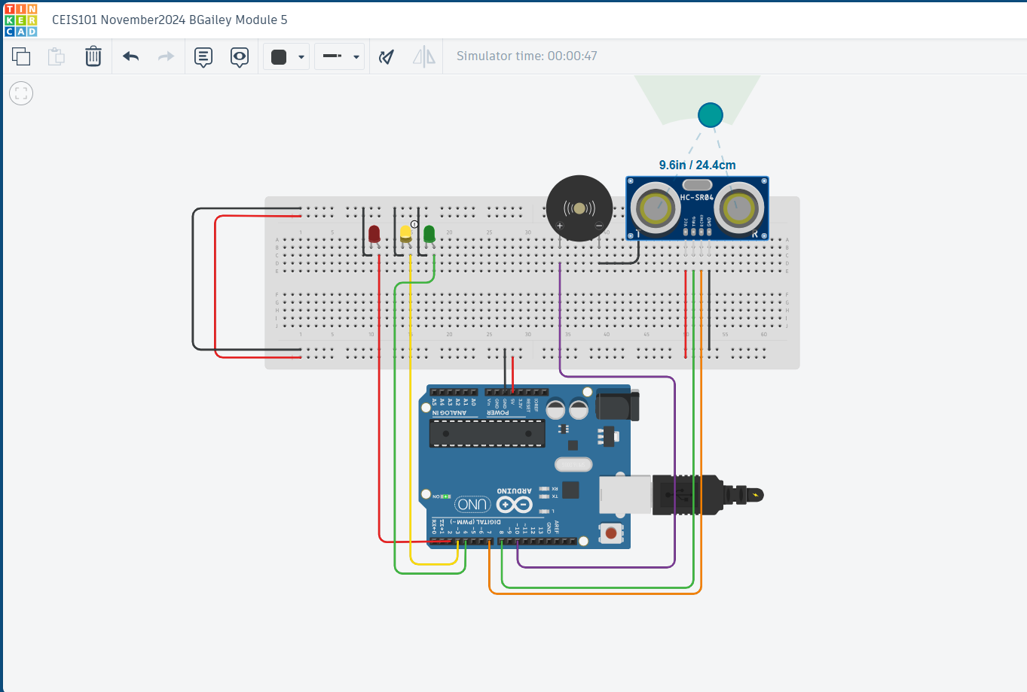
Circuit with yellow LED on (picture)

Slide 18
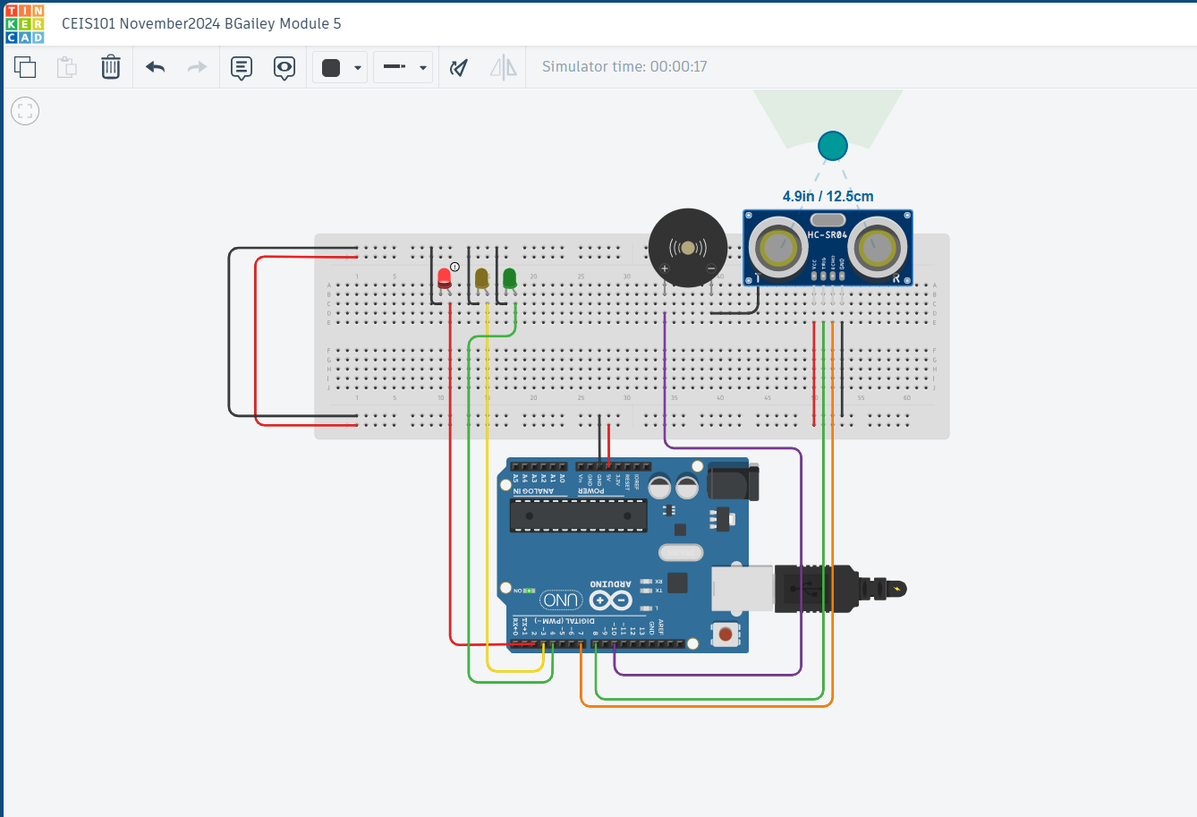
Circuit with red LED on (picture)

Slide 19
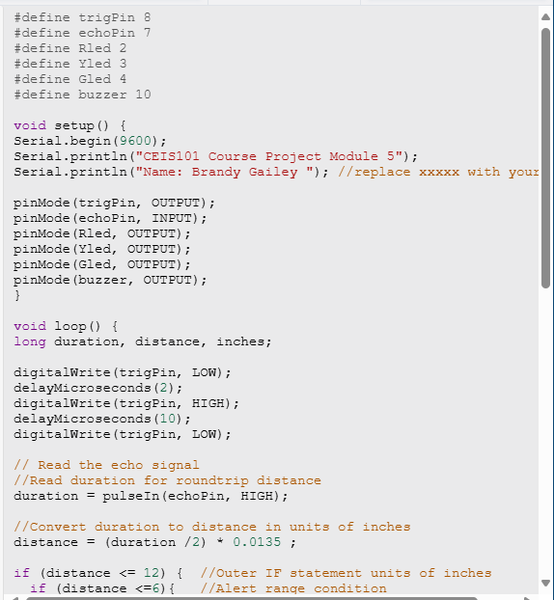
Arduino Code (screenshot)

Slide 20
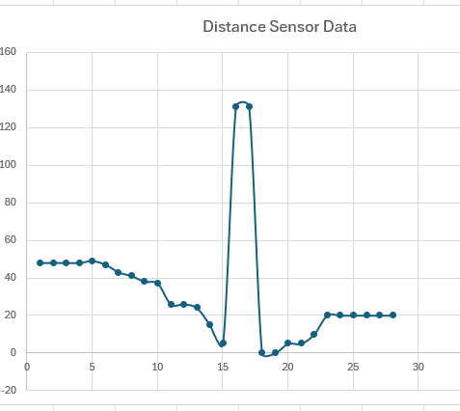
Plot of data (graph from Excel)

Slide 21
CEIS101
Module 6
Adding Automated Light to Smart Home System

Slide 22
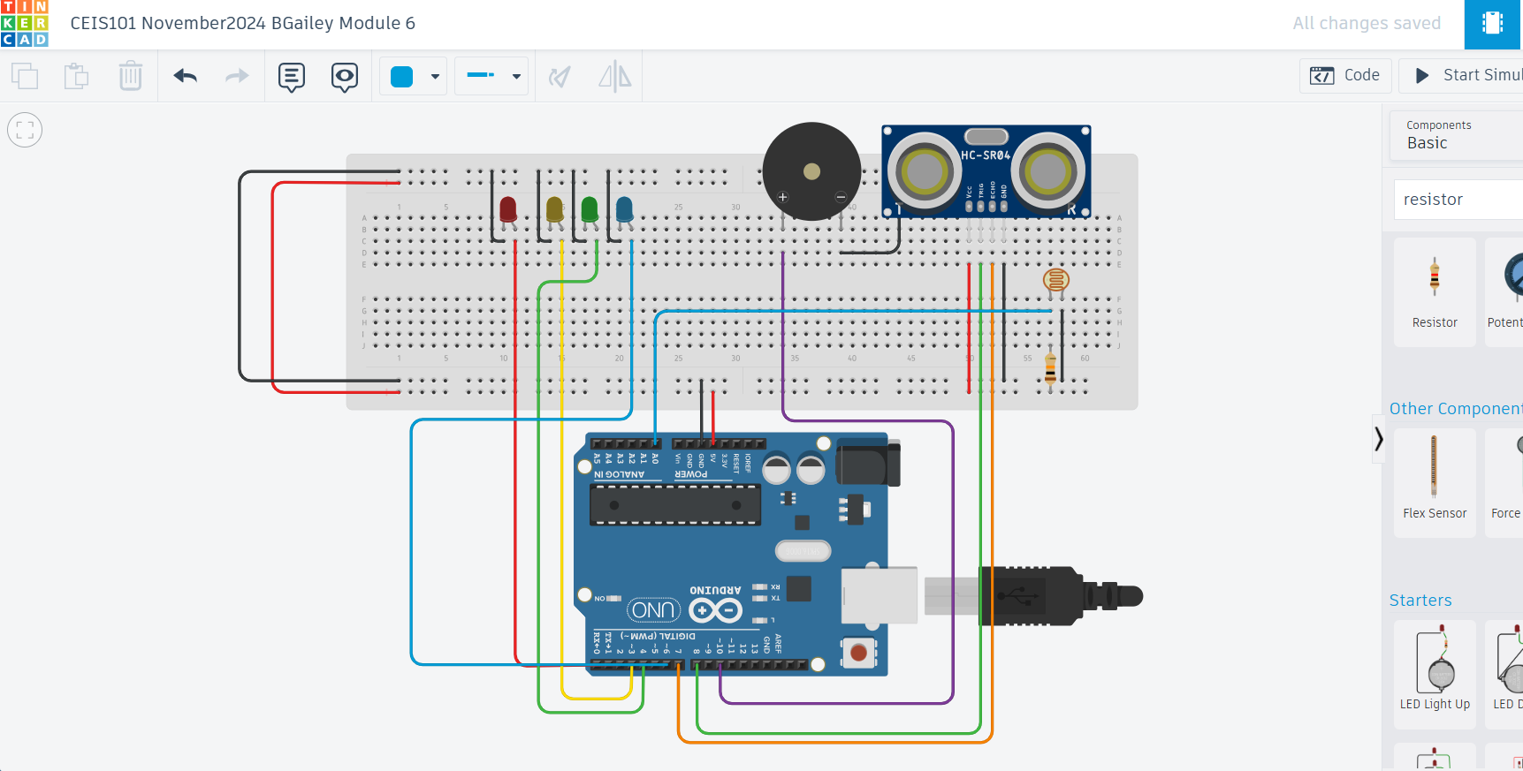
Circuit with automated LED off (picture)

Slide 23
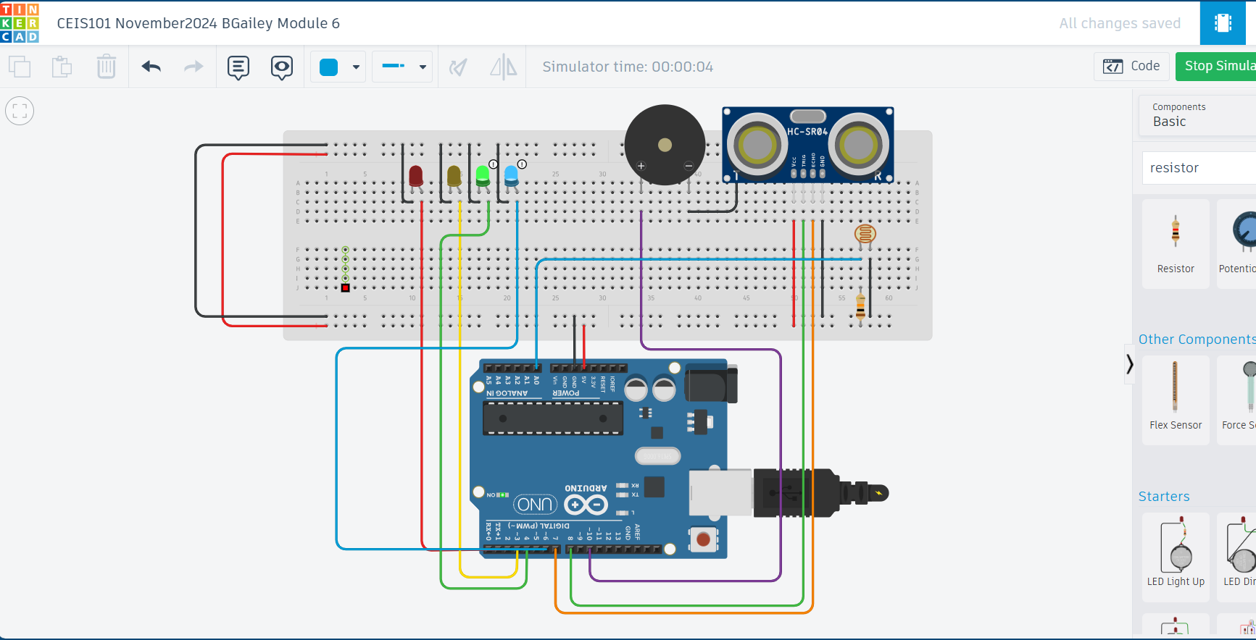
Circuit with automated LED on (picture)

Slide 24
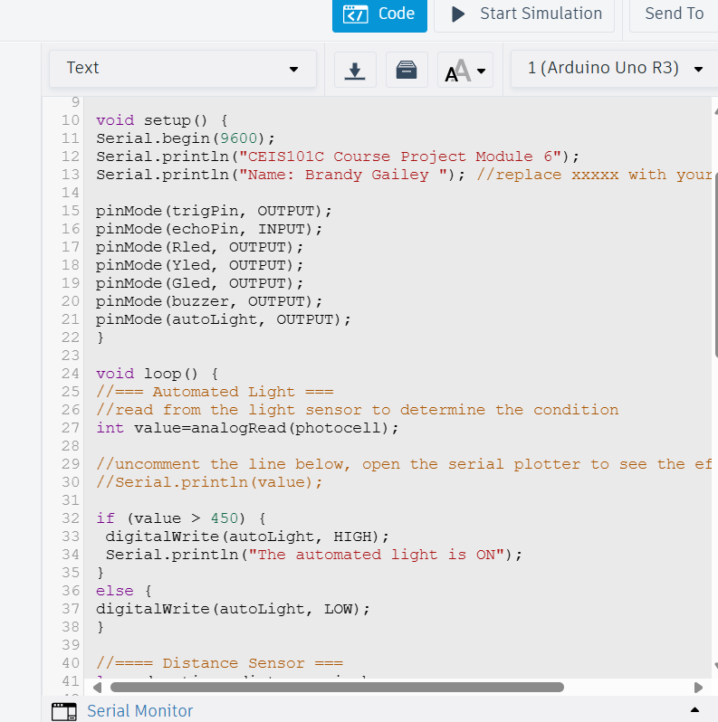
Arduino Code (screenshot)

Slide 25
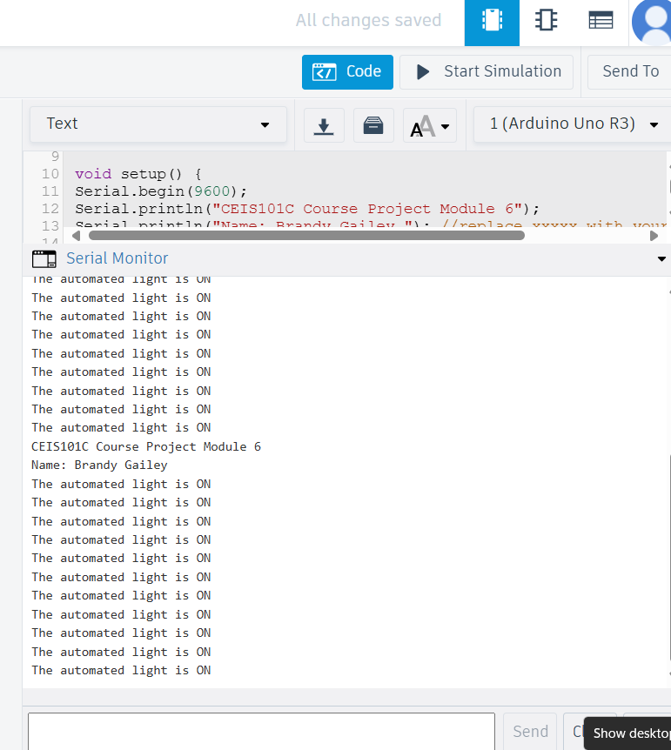
Serial Monitor (screenshot)

Slide 26
Challenges/Lessons Learned
The challenge I faced while working on the project was learning how to navigate Tinkercad because it was new for me. I was nervous to use it in the beginning but once I started the assignment and followed along with the instructions, it became easier each time.
The lessons I learned were how to properly plan each week’s project to ensure I meet the deadline for submission.
Another lesson I learned was how to apply the knowledge I learned in the course readings to the project itself. I learned that being hands-on is important for mastering concepts and tools.

Slide 27
Career Skills
Skills that I developed to benefit my career are critical thinking skills and project management. Since this was not a group project, I learn what it was like to complete a project from start to finish on my own and holding myself accountable.
Competencies that will help me gain the opportunities to advance my career are earning certifications along the way to help build my resume and being analytical, learning to code, and problem-solving just to name a few.

Slide 28
Conclusion
In conclusion, I enjoyed learning about the fundamental concept of IoT. I learned how to use Tinkercad, a software that I wasn’t familiar with prior to starting this course. I also enjoyed building upon the project each week, it made it easier to understand and wasn’t as overwhelming as I expected it to be. I now know how to build a smart home automation and security system. Lastly, I am more familiar with how hardware, software, and networks work together to create a system.

