Slide 1

SEC285 Final Project
Brandy Gailey

Slide 2
Introduction
This project summarizes what I’ve learned in Fundamentals of Information System Security (SEC285) over the past weeks. The course covered key topics like common security threats, defense mechanisms, and the principles of confidentiality, integrity, and availability. It also explored how people, data, networks, and devices can be protected using both technology and security policies. This project highlights my understanding of these concepts and how I plan to apply them in real-world situations and my future career in cybersecurity.

Slide 3

SEC285
Module 2
Asymmetric Key Encryption

Slide 4
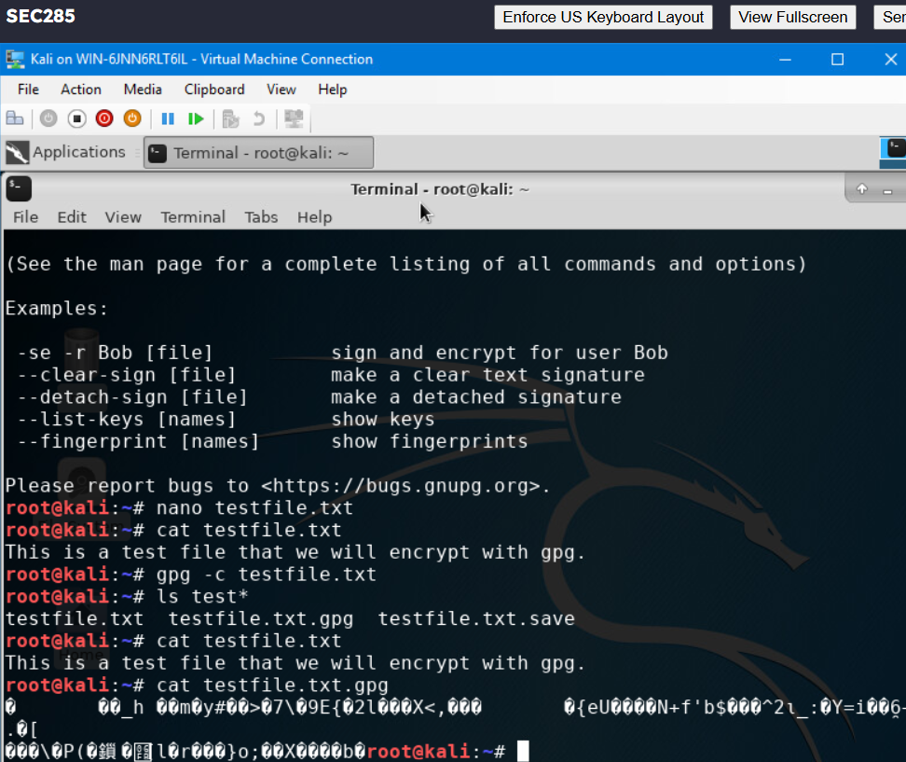
File Encryption
This screenshot should show the following.
Content of the plaintext file
Content of the encrypted file

Slide 5
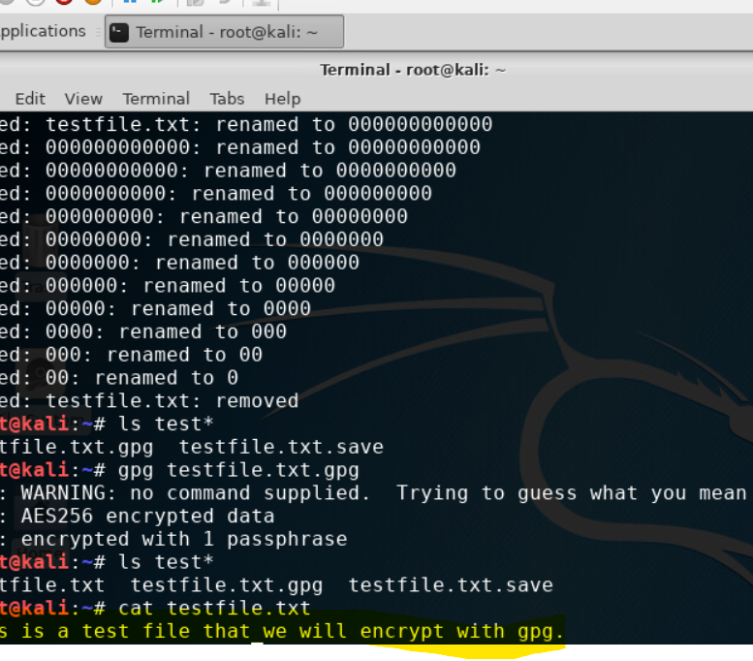
File Decryption
This screenshot should show the following.
The encrypted file being listed by itself
The decrypting process
Both the encrypted file and the original plaintext file being listed

Slide 6
SEC285
Module 3
Stateful Firewall

Slide 7

Question
What effect does the sudo iptables --policy INPUT DROP command have on the access to computing resources?
Answer here: The sudo iptables --policy INPUT DROP command sets the default policy for the INPUT chain to DROP. This means that all incoming network traffic to the server will be blocked unless explicitly allowed by other rules.
References: lab video

Slide 8
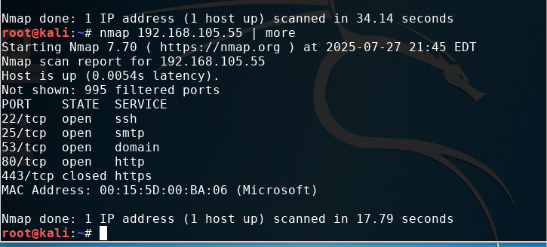
Nmap Scan
This screenshot should show the Nmap scan result of the Linux Server VM.

Slide 9
SEC285
Module 4
Bring Your Own Device (BYOD)
Security Policy

Slide 10

Overview:
Tablets, smartphones, and laptops are essential in modern business for mobility, remote work, and resource access. Laptops are preferred for their power and enterprise software. Smartphones are used for email, messaging, and two-factor authentication, while tablets are popular in healthcare, retail, and field services for quick data entry and presentations. However, these devices pose security risks: smartphones and tablets connected to public Wi-Fi are vulnerable to man-in-the-middle attacks, malicious apps, phishing, and data leakage. Laptops face ransomware, malware, data theft, especially with weak security. Device loss or theft risks unauthorized data access. BYOD policies add security challenges, as personal devices may lack proper encryption, updates, and enterprise controls.
2. Purpose:
The timely discovery of vulnerabilities in BYOD devices helps reduce the attack surface by preventing insecure or compromised devices from accessing corporate resources. Identifying and addressing these risks early stops attackers from exploiting outdated software, weak credentials, or unpatched systems, thereby protecting the confidentiality, integrity, and availability of organizational data.

Slide 11
3. Scope:
This policy applies to employees, contractors, and temporary staff wanting to connect personal devices like smartphones, tablets, and laptops to the organization's network. Devices need formal approval from IT before access. Personal devices can only be used for business activities; personal use must not threaten security or data confidentiality. IT security grants permission and ensures devices comply before connecting to company resources.
4. Policy:
All BYOD devices must undergo a security assessment before being granted access to ABC Corporation’s network. To be compliant, a device must run an approved operating system with the latest security patches installed, have up-to-date antivirus software with real-time protection enabled, and have a firewall and strong password protection in place. Devices that fail to meet these requirements will be denied network access until they are remediated. The responsibility for remediation lies with the device owner, and IT Security will verify compliance before granting approval for network access.

Slide 12
5. Policy Compliance:
The Information Security (InfoSec) team will verify compliance with this policy through various methods, including but not limited to periodic walk-throughs, video monitoring, intrusion detection tools, business tool reports, internal and external audits, and feedback to the policy owner. Employees found to have violated this policy may be subject to disciplinary actions up to and including termination of employment.
6. Related Standards, Policies, and Processes:
Relevant standards include HIPAA (Health Insurance Portability and Accountability Act), which mandates the protection of sensitive health information, and PCI-DSS (Payment Card Industry Data Security Standard), which requires secure handling of payment card data. Additionally, this policy complements the organization’s overall Information Security Policy, Acceptable Use Policy, and Incident Response Procedures, ensuring a consistent approach to securing all devices accessing corporate resources. Linking these documents ensures comprehensive coverage of security requirements and helps maintain regulatory compliance.
]

Slide 13
7. Definitions and Terms:
BYOD (Bring Your Own Device) is a policy that welcomes employees to use their own devices, like smartphones, tablets, and laptops, to connect to work networks and access resources. Mobile Devices are portable gadgets, including smartphones, tablets, and laptops, that can easily connect to the organization’s network. The CIA Triad highlights the three key principles of information security: Confidentiality, which means keeping data accessible only to those who are authorized; Integrity, which involves ensuring data remains accurate and complete; and Availability, which guarantees reliable access to data and systems whenever needed.
8. Revision History:
Date of change | Responsible | Summary of change
August 2019 | SANS policy team | Updated and converted to new format
August 2025 | Brandy Gailey | Completed a Bring Your Own Device (BYOD) security policy.

Slide 14
SEC285
Module 5
Multifactor Authentication (MFA)

Slide 15
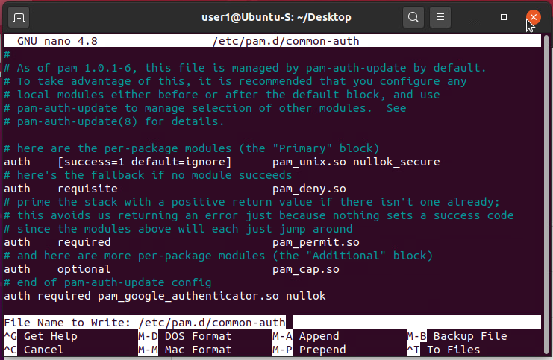
Common-auth Configuration File
This screenshot should show the entry that indicates the use of the Google Authenticator module.

Slide 16
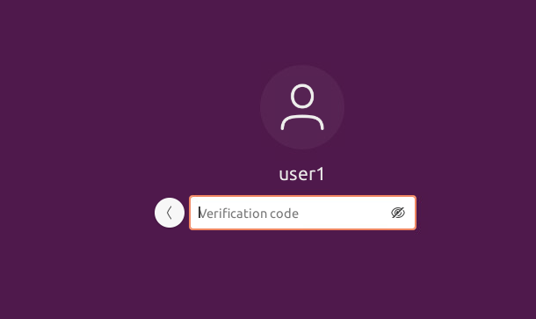
MFA Logon Screen
This screenshot should show the logon screen where a verification code is required.

Slide 17
SEC285
Module 6
Vulnerability Assessment

Slide 18
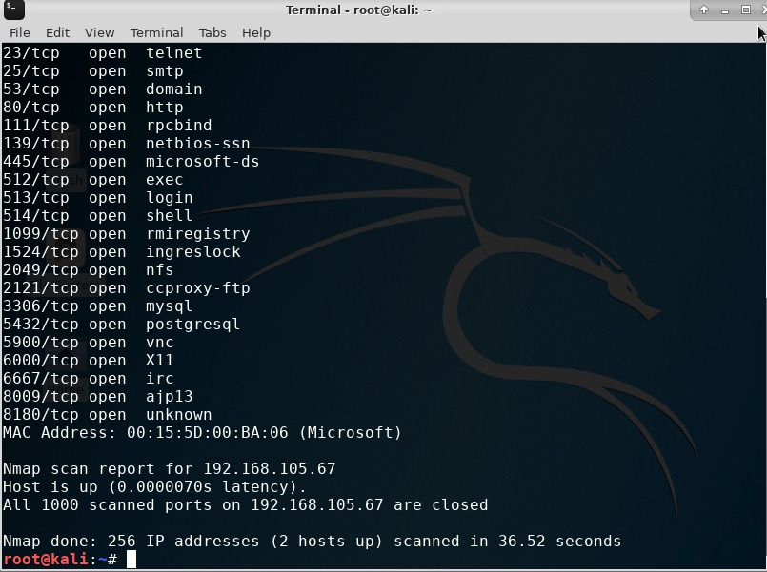
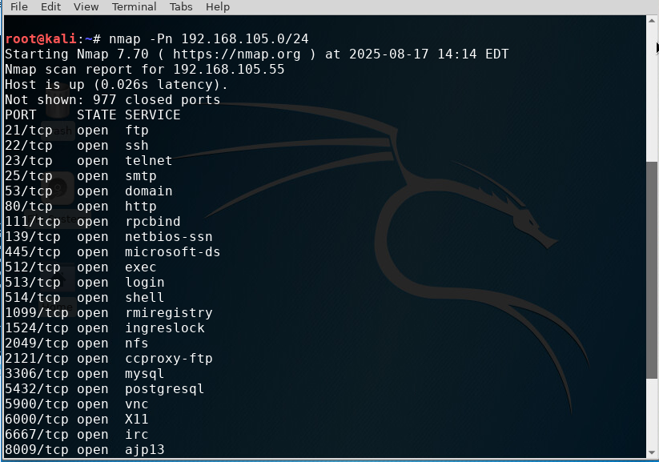
Nmap
This screenshot should include the scan result showing both the Kali and Linux Server VMs.

Slide 19
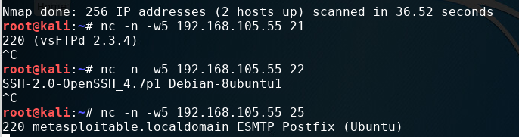
NetCat
This screenshot should include the scan result showing both the Kali and Linux Server VMs.

Slide 20
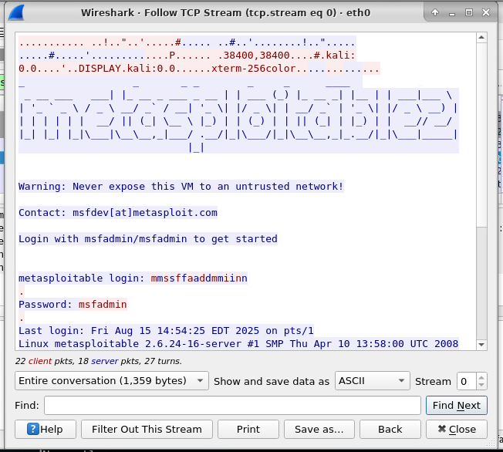
Wireshark
This screenshot should include the Wireshark—Follow TCP Steam window showing the Telnet username and password.

Slide 21
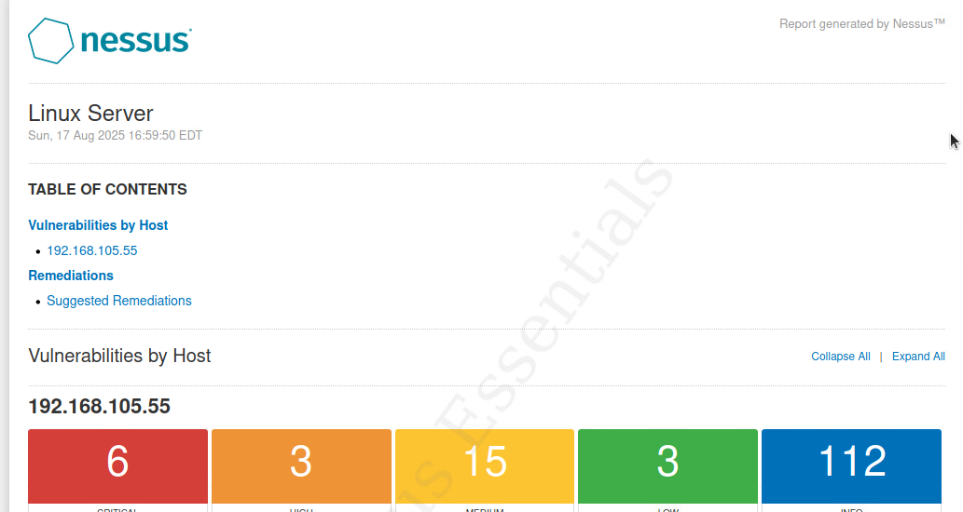
Nessus
This screenshot should include the high-level view of the Nessus vulnerability scan report (showing categories of vulnerability in different colors).

Slide 22
Challenges
Understanding technical concepts: Some of the security principles, like encryption, authentication, or network defense mechanisms, can be hard to grasp at first.
Keeping up with terminology: Information security has a lot of acronyms (CIA triad, IDS, IPS, VPN, etc.) that can feel overwhelming.

Slide 23
Career
I plan to use this course as a foundation for building my career in cybersecurity by applying the knowledge of security principles, attacks, and defense mechanisms to real-world situations. The understanding I’ve gained of confidentiality, integrity, and availability will help me design and follow security policies that protect data, networks, and devices in the workplace. This course also gives me a starting point for pursuing certifications like CompTIA Security+, which can strengthen my qualifications for entry-level security positions.

Slide 24
References
My references were the course instruction videos.

Slide 25
Conclusion
Overall, this course gave me a solid introduction to the world of information security. I learned how different threats can impact people, data, networks, and devices, and also how important it is to apply the principles of confidentiality, integrity, and availability. The topics we covered gave me both practical knowledge and a better understanding of how security works in real-life situations. I feel more confident moving forward in my career path and know this course has given me skills I can continue to build on in the future.

